Slide 1
Sea Level Rise Near Coastal Military Installations OA3801 Final Project Presentation
Team HarborTide
John Berner, Conrad Urban, Thomas Stone
OA3801 - Winter 2024

Slide 2
Overview
The Problem
Scoping the Problem
Finding the Data
Collaboration
Input Data
Analysis
Future Work

Slide 3
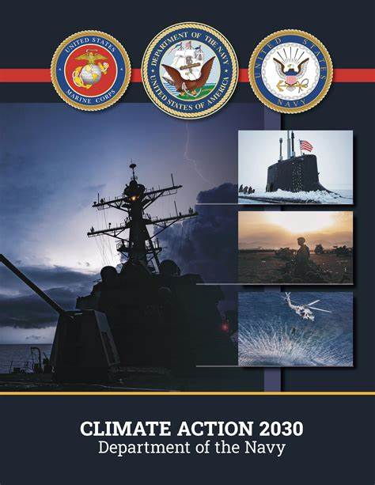
The Problem
“If we do not act, as sea levels rise, bases like Norfolk Naval Base and Marine Corps Recruit Depot Parris Island will be severely tested in their ability to support their missions” – Department of the Navy, Climate Action 2030, p. 3
In 2022, the Secretary of the Navy issued guidance for climate action in the Department of the Navy via Climate Action 2030.
Recognizing trends of climate change will aid in addressing threats climate change poses to the Navy and Marine Corps' operational readiness.
Success is recognizing temporal climate change trends, leading to further research, investment, and decision-making to achieve SEVNAV's goal of "building a climate-ready force."

Slide 4
Scoping the Problem
This is a huge problem facing every coastal installation in the DoD
Finding Data and Looking for Trends
A smaller case study for more general analysis
What does success look like?

Slide 5
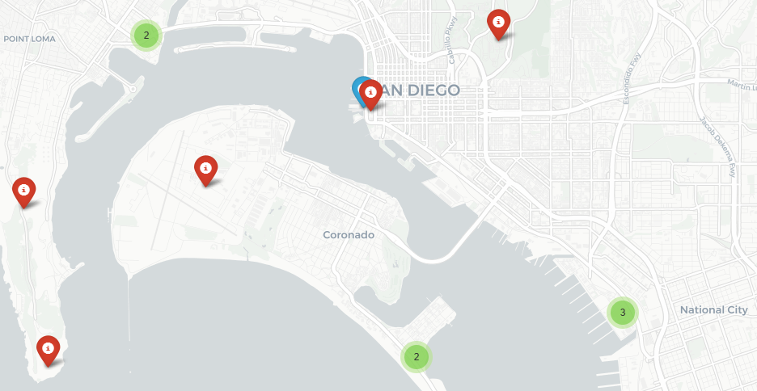
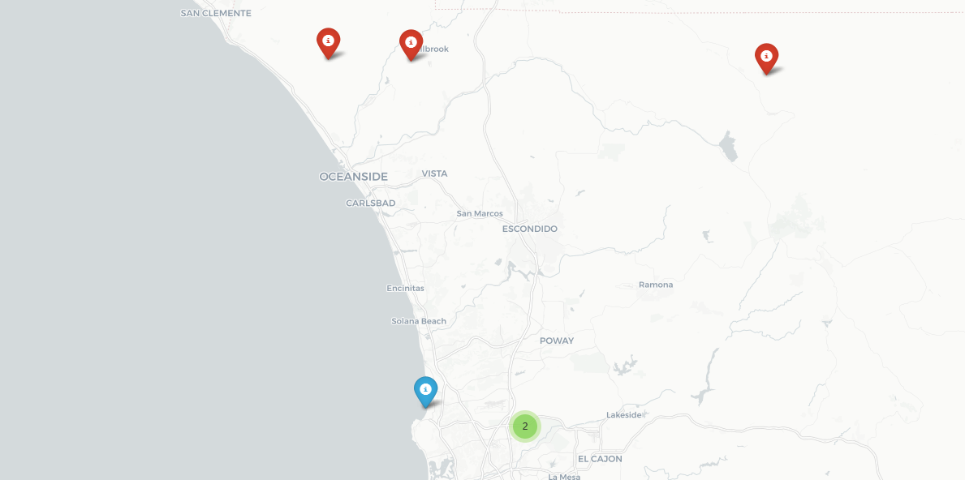
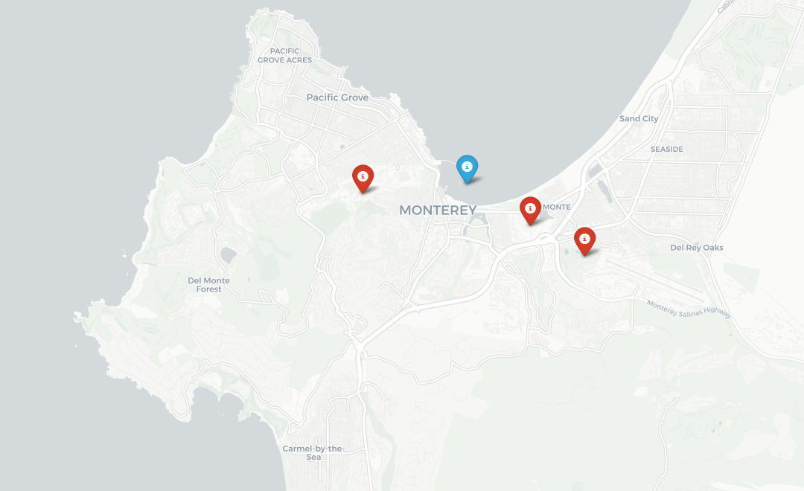
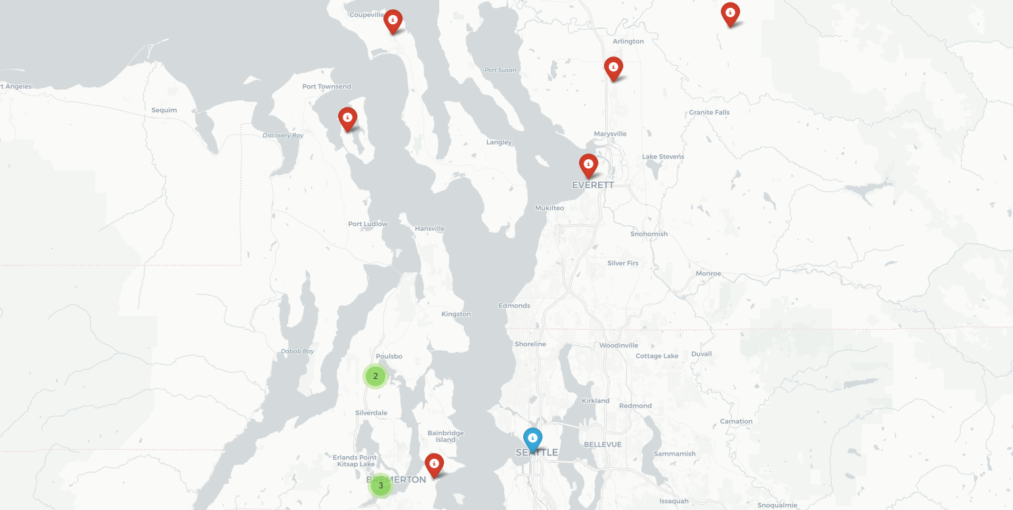
Bases We Analyzed
Folium maps depicting the location of 4 of the sensors used for collecting water level data from NOAA National Centers for Environmental Information, U.S. Tsunami Program Coastal Water Level data Inventory. Sensors are shown in Blue, Bases in Red.
Base: NAVSTA San Diego Sensor: San Diego Bay
Base: MCB Camp Pendleton, Sensor: La Jolla
Base: NAVSUPPACT Monterey, Sensor: Monterey Harbor
Base: NAVSTA Everett, Sensor: Puget Sound

Slide 6



Finding the Data
There is a LOT of (open source) quality ocean and tidal data available
There are a lot of coastal military bases
Data isn’t always free to access

Slide 7
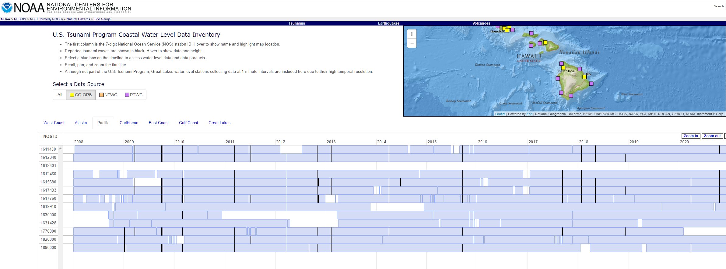
Finding the Data: Missing Information

Slide 8
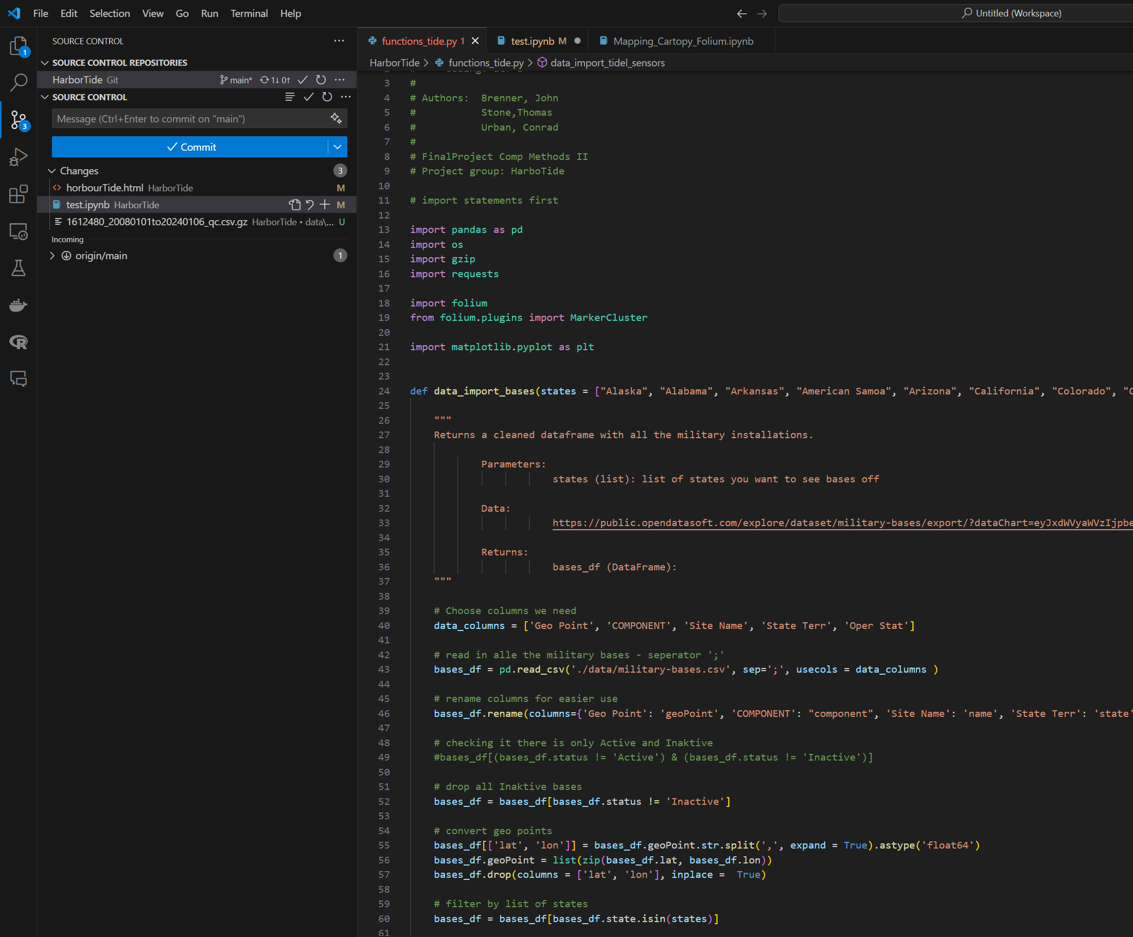
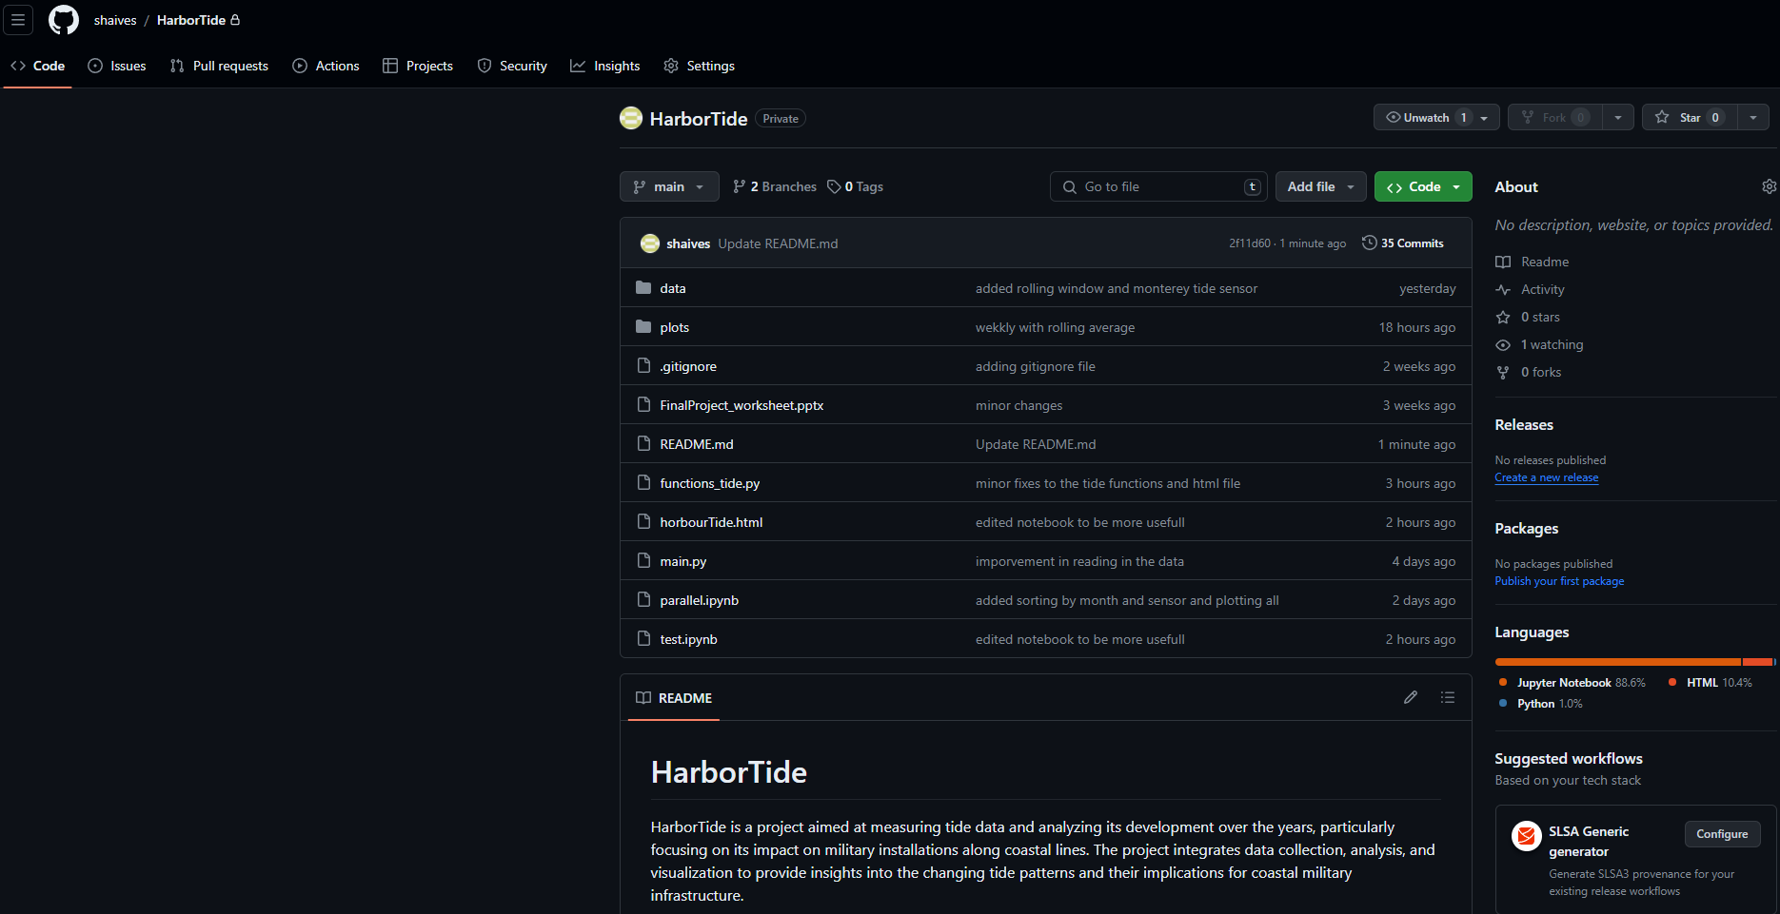
Collaboration: VS Code / Github
GitHub Repository
Insert pictures of Github and VS Code here.

Slide 9
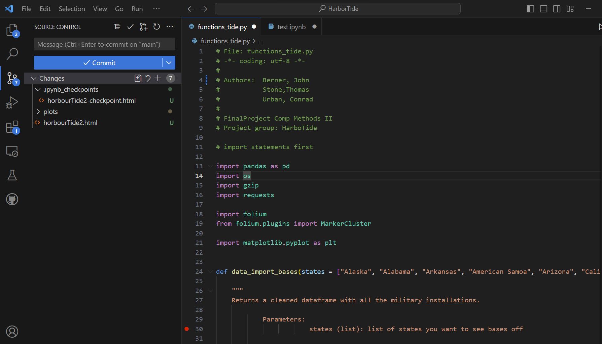
Collaboration: VS Code / Github

Slide 10
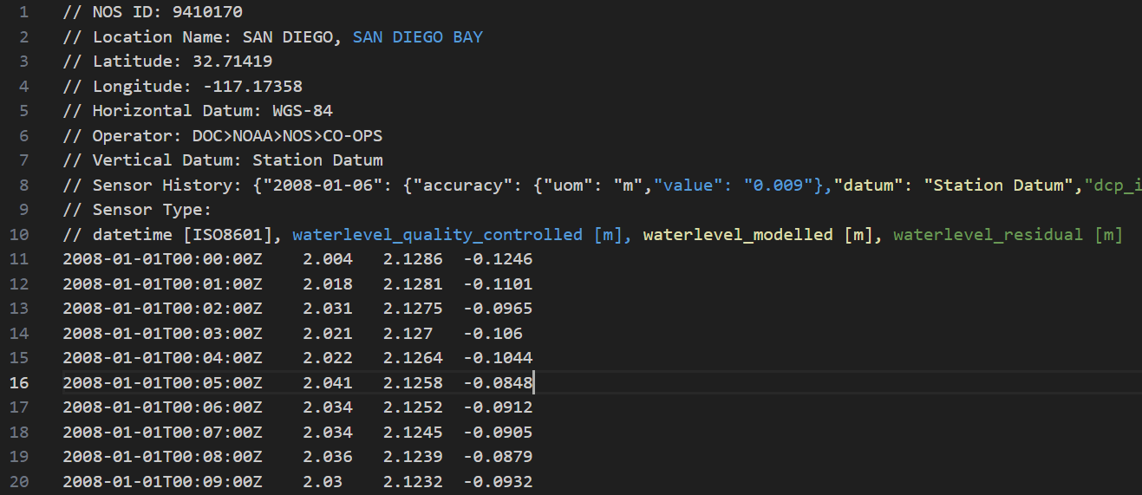
Analysis
Each data set needed to be parsed and cleaned before it could be loaded into a pandas data frame and analyzed.

Slide 11
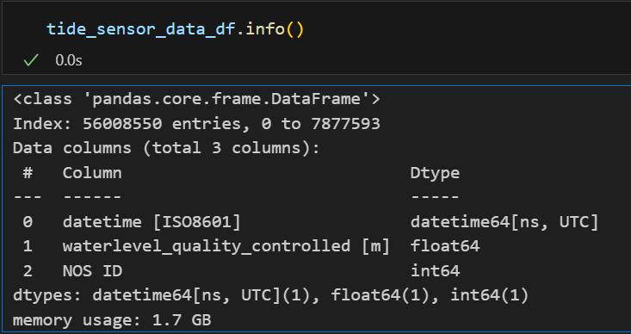
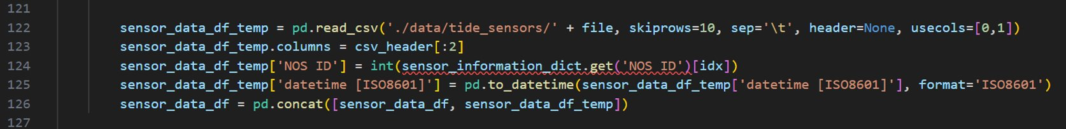
Analysis
Analysis
Dataframe of sensor data contained ~56 million datapoints, and ~7 million rows
Data is collected by height from the sensor datum in meters.
Data collected in intervals of one minute over 16 years.
Which of these lines is the most time intensive?

Slide 12
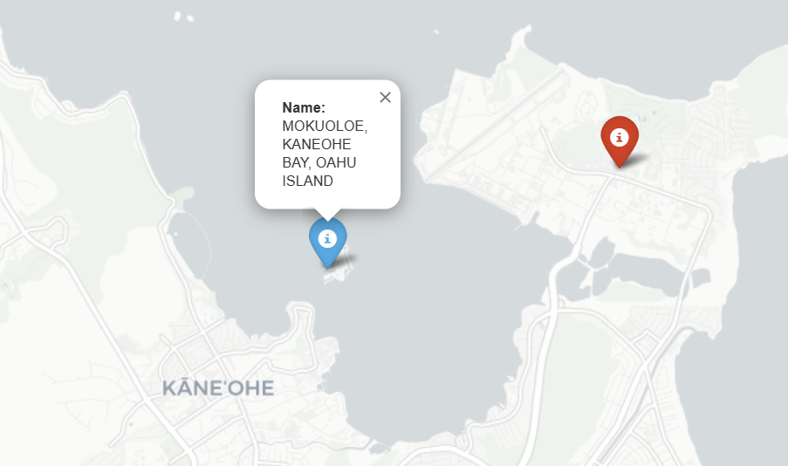
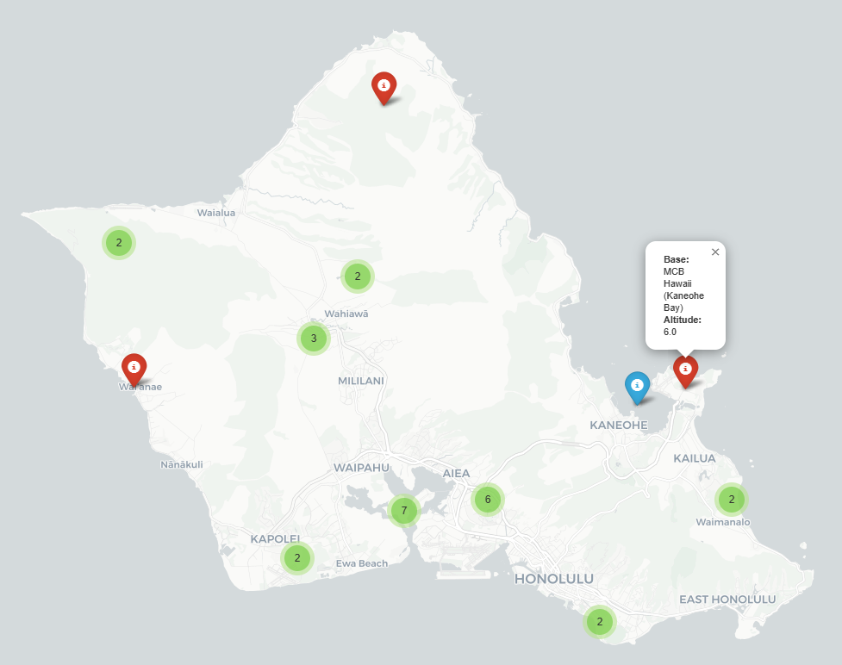
Analysis
Map showing MCB Hawaii and 28 other military bases from our data, including Joint Base Pearl Harbor-Hickam.

Slide 13
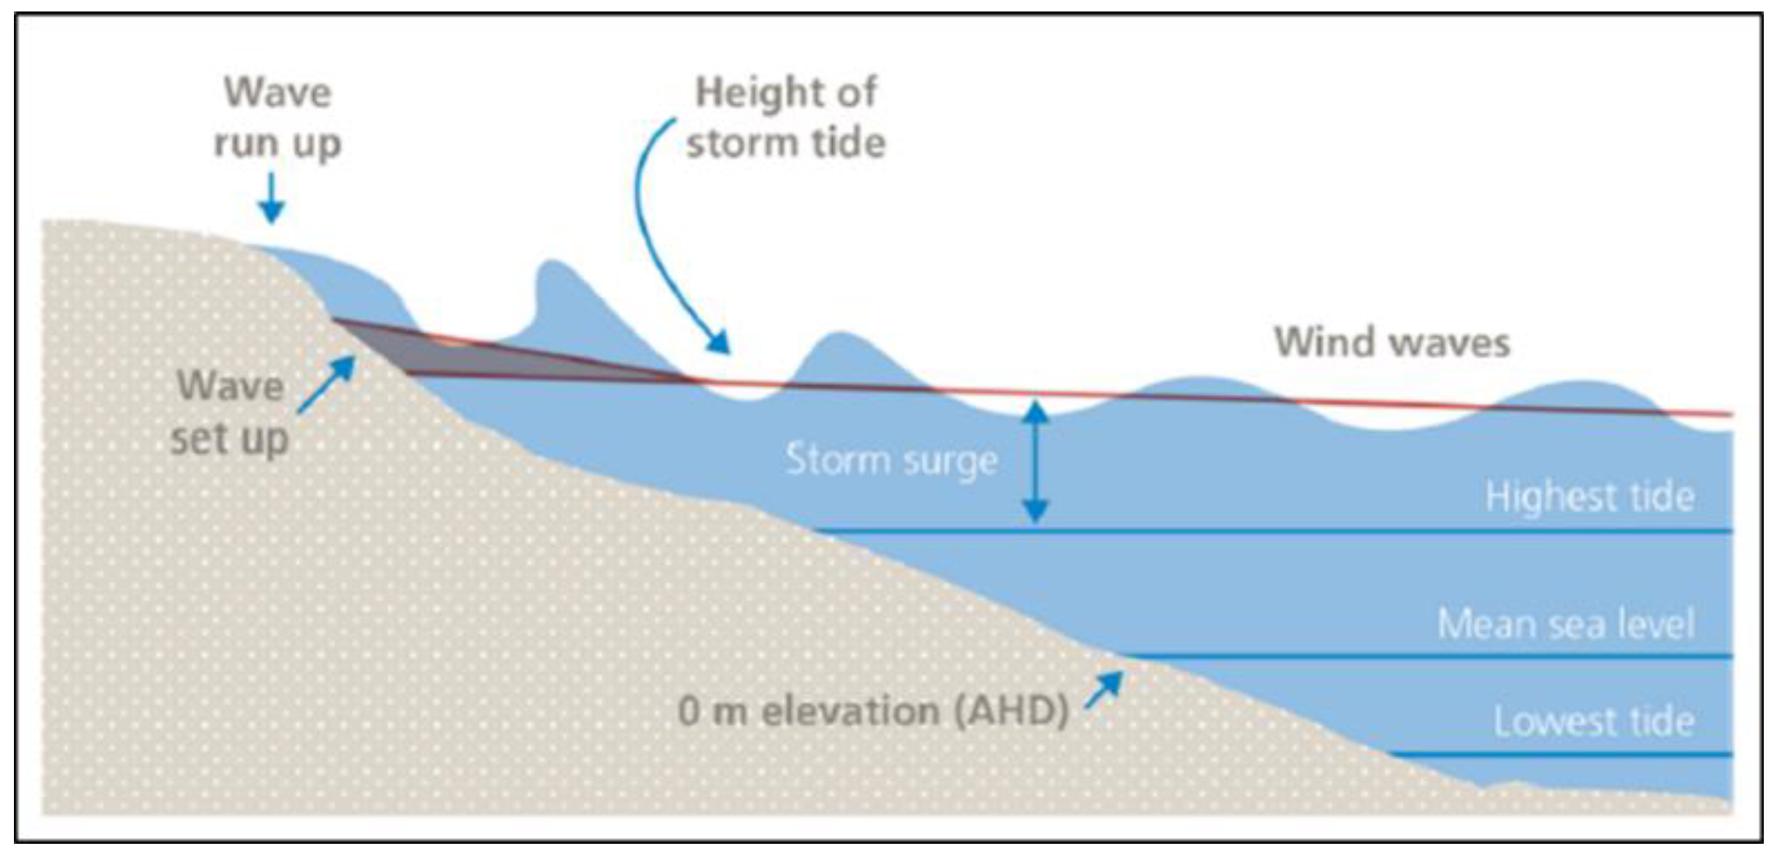
Analysis
Visual display of coastal measurements. For our purposes we are interested in the lowest three: Highest tide, Mean sea level, and Lowest tide for different periods to measure trend over time.

Slide 14
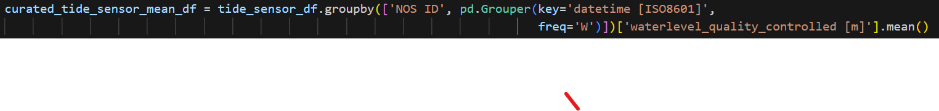
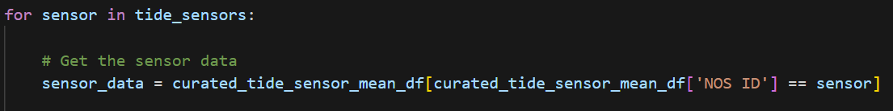
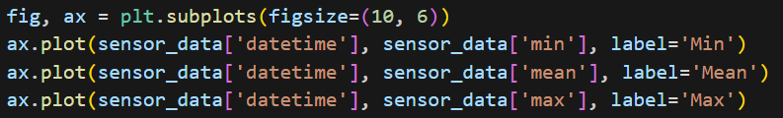
Generating the Plots (Mean Example)

Slide 15
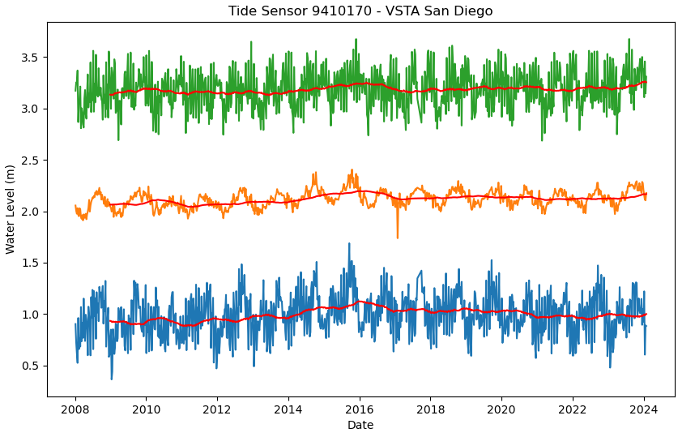
Sensor Data
Minimum average is about 1 m and Maximum average is above 3 m
Base elevation is around 5 m

Slide 16
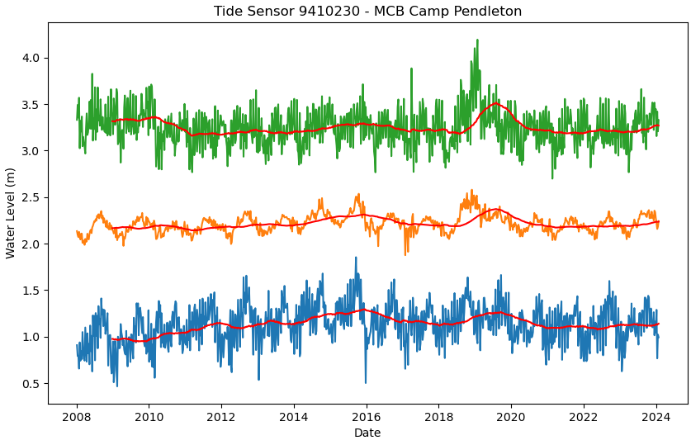
Sensor Data
From Data Source: “from 2008/01/01 to 2010/03/02 and from 2010/03/03 to present. The data on the first segment is very spiky probably due to calibration issue of the sensor.”

Slide 17
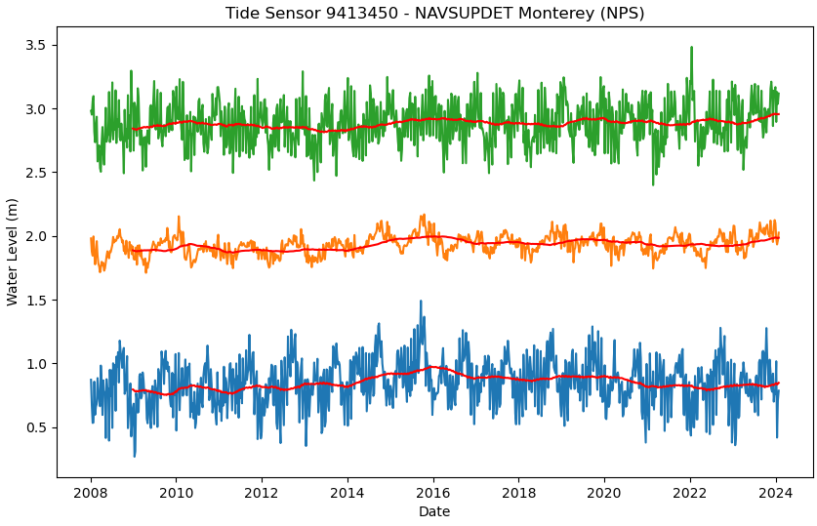
Sensor Data
Minimum average is below 1 m and Maximum average is below 3 m
Base elevation is around 6 m

Slide 18
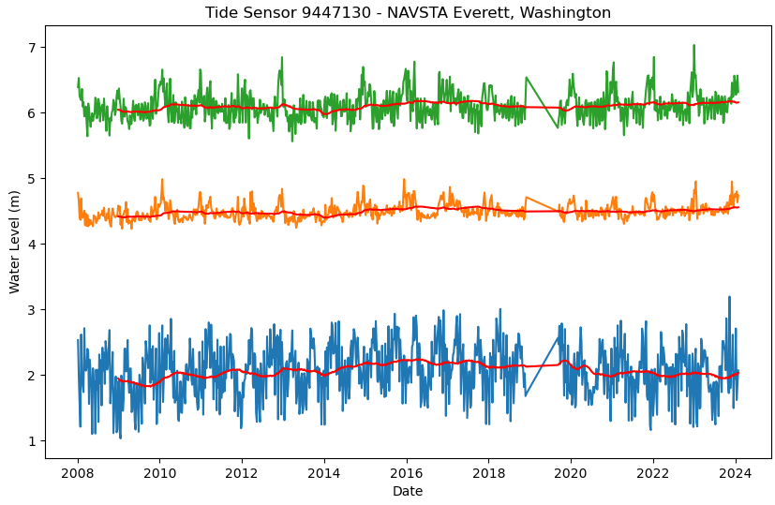
Sensor Data
Observations missing in 2018 and 2019
From DataSource: “Good quality observations end at 2018-11-30 23:08:00…Regular observations are restored on 2019-09-06.”

Slide 19
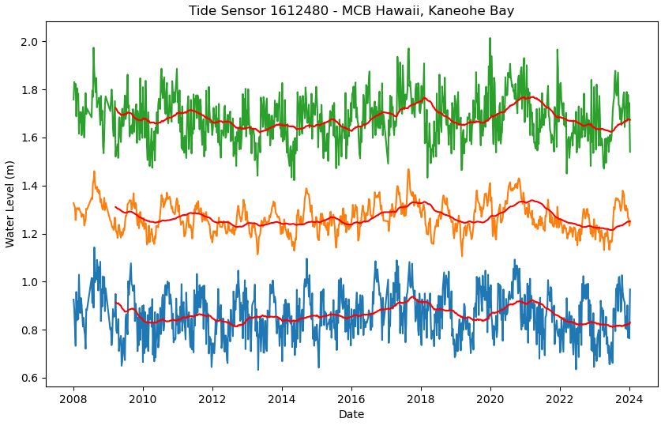
Sensor Data
Data Averages fluctuate more than the other sensors, likely due to geographic location
Minimum average is around 0.9 m and Maximum average is around 1.7 m
Base elevation is around 6 m

Slide 20


Future Work
Generalization (looking at other bases near other sensors)
Expanding to look at the coastline around bases and flooding (potential decision variables)
Many more data sets and sensor types to be analyzed

Slide 21
Questions?

